Slide 1

MAHATMA GANDHI INSTITUTE OF TECHNOLOGY(A)
DEPARTMENT OF INFORMATION TECHNOLOGY
An Industry Oriented Mini Project(IT652PC)
on
AI-POWERED CHAT BOT FOR STREAMLINING ADMISSION ENQUIRIES
by
ABDUL RASHEED(22261A1202)
KANAKA SHARON(22261A1229)
IOMP ID:IT-25-22
INTERNAL SUPERVISOR:-
Dr. M. RUDRA KUMAR
IOMP Supervisor
Dr. U Chaitanya

Slide 2
MAHATMA GANDHI INSTITUTE OF TECHNOLOGY(A)
DEPARTMENT OF INFORMATION TECHNOLOGY
An Industry Oriented Mini Project(IT653PC)
On
AI-POWERED CHAT BOT FOR STREAMLINING ADMISSION ENQUIRIES
by
ABDUL RASHEED(22261A1202)
KANAKA SHARON(22261A1229)
IOMP ID:IT-25-22
INTERNAL SUPERVISOR :
Dr. M. Rudra Kumar
Professor
IOMP Supervisor
Dr. U Chaitanya
Assistant Professor

Slide 3

OUTLINE
ABSTRACT
INTRODUCTION
EXISTING SYSTEM
PROPOSED SYSTEM
APPLICATIONS
REQUIREMENTS
LITERATURE SURVERY
PROBLEM STATEMENT
OBJECTIVES
MODULES DESCRIPTION
ALGORITHM
DESIGN ARCHITECTURE&UML DIAGRAMS
REFERENCES

Slide 4
ABSTRACT
The increasing volume of admission-related inquiries in engineering institutes makes the process cumbersome for students, parents, and administration.
This project proposes an AI-powered chatbot to provide instant responses to FAQs on admission procedures, eligibility, fees, scholarships, curriculum, hostel facilities, cutoffs, and placements.
The chatbot will RAG to handle text queries in English, ensuring quick and accurate information retrieval.
Automating responses will reduce administrative workload, enhance user experience, and provide data-driven insights for institutions to improve their services.

Slide 5

INTRODUCTION
Students and parents often have numerous queries regarding the admission process, eligibility, fees, and other college- related details.
Manually addressing each inquiry can be time-consuming and inefficient for college administration.
To streamline the process, integrating technology with the admission system is essential.
With the help of AI and RAG, we can develop a chatbot to handle and automate responses to common queries.
The chatbot will assist users by providing instant answers, reducing workload, and improving the overall admission experience.

Slide 6
EXISTING SYSTEM
Shiksha :
ChatbotHelps users explore colleges, entrance exams, and deadlines.
Tech: Web-based, with basic conversational flow.
Limitations:
Not personalized.
Doesn’t offer real-time human support.
2.Chatbot on University Websites :
Provides basic admission-related FAQs through a chatbot on their official site.
Tech: Mostly rule-based or scripted.
Limitations:
Static responses.
Doesn’t adapt or learn from user behavior.

Slide 7
PROPOSED SYSTEM
The system introduces an AI-powered chatbot that automatically responds to admission-related queries, reducing the need for manual intervention. It is available 24/7 through a user-friendly web interface and can be accessed on both desktops and ensuring continuous support.The chatbot handles frequently asked questions like admission procedures, eligibility, fees, scholarships, hostel facilities,and placements, offering instant and accurate responses.
It uses Retrieval-Augmented Generation (RAG) to understand and respond to user queries in a conversational manner, combining relevant information from institutional data with the power of language models. This enhances the accuracy and context-awareness of responses, improving user experience. All user interactions are logged and stored in CSV files, enabling institutions to analyze query trends and improve their services based on real user concerns.

Slide 8
APPLICATIONS
24/7 Admission Support
Automated FAQ Handling
Admission Process Guidance
College Information Access
Reduced Administrative Workload

Slide 9

HARDWARE AND SOFTWARE SPECIFICATIONS
Software Specification:
Backend: Python with FastAPI Framework
Data Handling: Pandas for CSV Data Management
Intelligence Layer: Retrieval-Augmented Generation (RAG) using LangChain, Qdrant, and Gemini Model
Vector Database: Qdrant for efficient vector-based similarity search
Storage: CSV files for logging user queries and responses
Frontend: React (React.js), with HTML and CSS for styling
Hardware Specifications
Processor: Intel i5 or higher.
RAM: Minimum 8GB (16GB recommended).

Slide 10
LITERATURE SURVEY:
S. No | Author Names, Year | Journal / Conference Name & Publisher | Methodology / Algorithms Used | Merits | Demerits | Research Gaps
1 | Umair Hasan Khan et al., 2025 | Procedia Computer Science (Elsevier) | Transformer-based LLMs (LLaMA-2, Mistral), RAG framework | High BLEU scores; scalable; real-time retrieval enhances ~95% accuracy | High computational cost; occasional factual errors | Needs fine-tuning for accuracy and low-latency optimization
2 | Mansur A. Sulaiman, 2025 | ABU Easy-Go! (Preprint) | RNN, BERT, NLP, Dialogflow, CMS integration | 95% accuracy post-optimization; 24/7 FAQ automation | May misinterpret nuanced queries; fixed intent limitations | Focus on reinforcement learning and multimodal input
3 | Franklin Parrales-Bravo et al., 2024 | IEEE Access | ANN, NLP, intent-based model, Telegram interface | 93–95% accuracy; well-accepted by students; evaluated via surveys | Platform limitation (Telegram-only); less effective for unseen queries | Needs multi-platform integration and improved handling of unknown intents
4 | Dhruv Patel et al., 2023 | IJRASET, India | NLP (tokenization, NER), rule-based vs ML chatbots, Azure deployment | Compared chatbot types; improved user experience; Azure-based system; ~90% accuracy | Limited real-time adaptability; simple dataset scope | Needs deep learning integration and real-time multi-platform scalability
5 | Trung T. Nguyen et al., 2021 | Computers & Education: AI (Elsevier) | Rasa framework, RNN, BERT, retrieval-based bot | 97.1% accuracy; effective for Facebook-based admission FAQ | Limited to retrieval logic; lacks generative flexibility | Needs generative enhancements and multi-language support

Slide 11
LITERATURE SURVEY:
S. No | Author Names, Year | Journal / Conference Name & Publisher | Methodology / Algorithms Used | Merits | Demerits | Research Gaps
1 | Umair Hasan Khan et al., 2025 | Procedia Computer Science (Elsevier),Conference | Transformer-based LLMs (LLaMA-2, Mistral), RAG framework | High BLEU scores; scalable; real-time retrieval enhances ~95% accuracy | High computational cost; occasional factual errors | Needs fine-tuning for accuracy and low-latency optimization
2 | Franklin Parrales-Bravo et al., 2024 | IEEE Access,Journal | ANN, NLP, intent-based model, Telegram interface | 93–95% accuracy; well-accepted by students; evaluated via surveys | Platform limitation (Telegram-only); less effective for unseen queries | Needs multi-platform integration and improved handling of unknown intents
3 | Dhruv Patel et al., 2023 | IJRASET, India, Journal | NLP (tokenization, NER), rule-based vs ML chatbots, Azure deployment | Compared chatbot types; improved user experience; Azure-based system; ~90% accuracy | Limited real-time adaptability; simple dataset scope | Needs deep learning integration and real-time multi-platform scalability
4 | Trung T. Nguyen et al., 2021 | Computers & Education: AI (Elsevier), | Rasa framework, RNN, BERT, retrieval-based bot | 97.1% accuracy; effective for Facebook-based admission FAQ | Limited to retrieval logic; lacks generative flexibility | Needs generative enhancements and multi-language support

Slide 12
PROBLEM STATEMENT
Across India, engineering colleges experience a surge in admission-related queries from students, parents, and other stakeholders—covering eligibility, fees, scholarships, placements, and more. Currently, these queries are handled through phone calls, emails, or personal visits, which are time-consuming and strain administrative resources.
To address this, a centralized AI-powered chatbot is proposed as a 24/7 virtual assistant that instantly responds to common queries in English. It will be accessible via web, offering a user-friendly interface for natural interactions. This solution will improve access to accurate information while significantly reducing the workload on college staff.

Slide 13
OBJECTIVES
To develop an AI-based chatbot system capable of accurately answering admission-related queries using RAG
To provide 24/7 automated assistance to students for admission procedures, eligibility, important dates, and required documents.

Slide 14
MODULES
Query Understanding & Preprocessing Module
Functions: Improves the question asked by the user. It creates different versions of the same question to understand it better and improve the chances of finding the right answer.
Input: User's question
Output: Several rewritten versions of the question
Information Retrieval Module
Functions: Searches the stored data to find the most relevant information that matches the user’s question. It collects helpful pieces of text to answer the question.
Input: Rewritten questions, Stored information
Output: Useful pieces of content related to the question

Slide 15
MODULES
Response Generation Module
Functions: Creates a final answer based on the information found. It writes a clear and helpful response using the collected content and the original question.
Input: User’s question, Information found
Output: A complete answer for the user
User Interaction Module
Functions: Handles the communication between the user and the system. It receives the question from the user and sends back the answer.
Input: Question asked by the user
Output: Answer shown to the user

Slide 16
MODULES
System Setup Module
Functions: Prepares everything when the system starts. It loads the information and gets the tools ready to answer questions.
Input: Stored information file, access to tools
Output: A ready system that can understand questions and find answers

Slide 17
ALGORITHM
Retrieval-Augmented Generation (RAG):
Load and prepare the data with important question-answer information.
Split the data into smaller parts for better matching.
Accept the user's question.
Generate multiple rewritten versions of the question.
Retrieve the most relevant information using all versions.
Combine the retrieved content into a useful context.
Generate the final answer using the original question and the context.
Display the answer to the user.

Slide 18
3. Hidden Layer (Intent Recognition Logic) Purpose: Determine the user’s intent using rule-based logic. We define categories (intents) like: Courses Fees Admissions Eligibility Deadlines Hostel Contact Method: We match the lemmatized tokens from user input with predefined keywords under each intent. If a match is found, we return a relevant response.
4. Response Layer (Knowledge Base)
Purpose: Provide a relevant, static response based on matched intent.
Each intent has a corresponding reply, stored in a csv file

Slide 19
5. Output Layer (Response Delivery)
Purpose: Display chatbot response on the web UI.
The chatbot returns a message like “The last date for admission is 30th June 2025.”
Response is sent as JSON from Flask backend to the frontend.

Slide 20
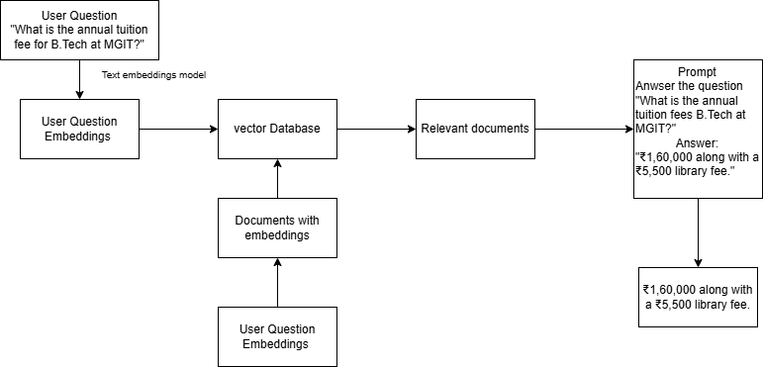
Architecture

Slide 21
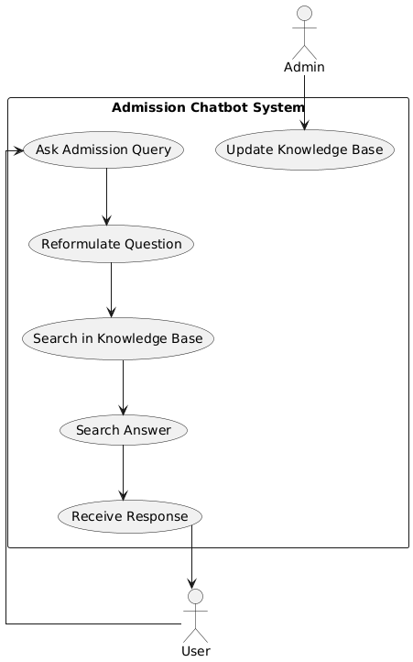
USE CASE DIAGRAM

Slide 22
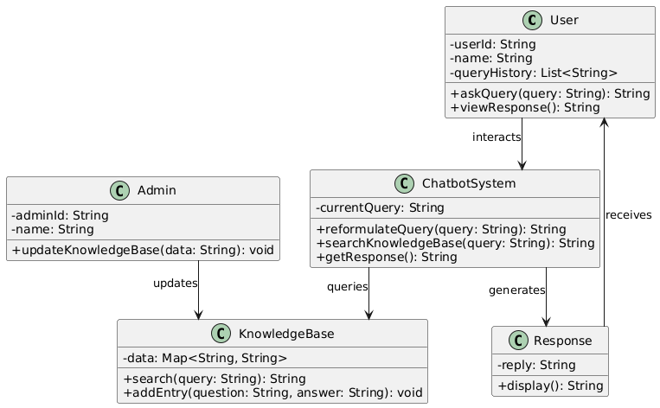
CLASS DIAGRAM

Slide 23
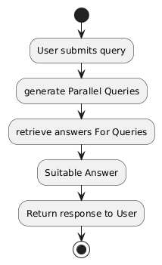
ACTIVITY DIAGRAM

Slide 24
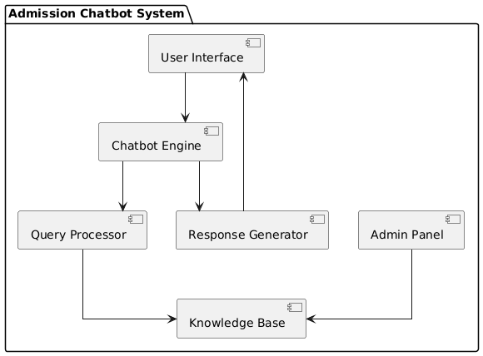
COMPONENT DIAGRAM

Slide 25
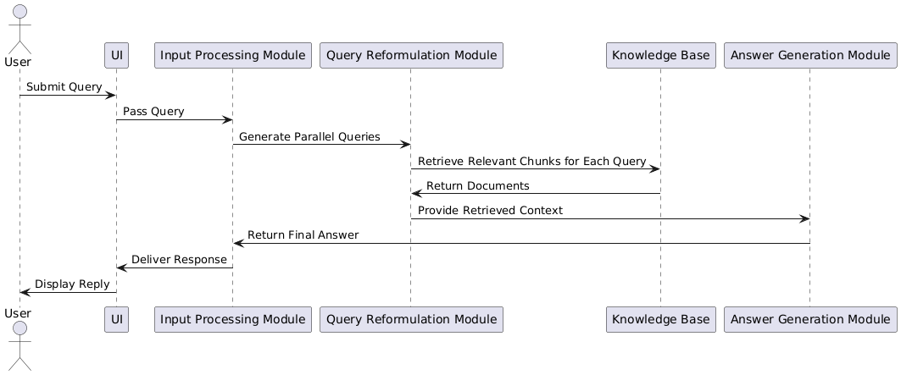
SEQUENCE DIAGRAM

Slide 26
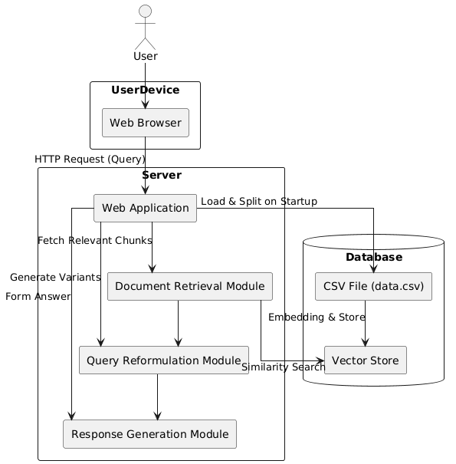
Deployment
Diagram

Slide 27
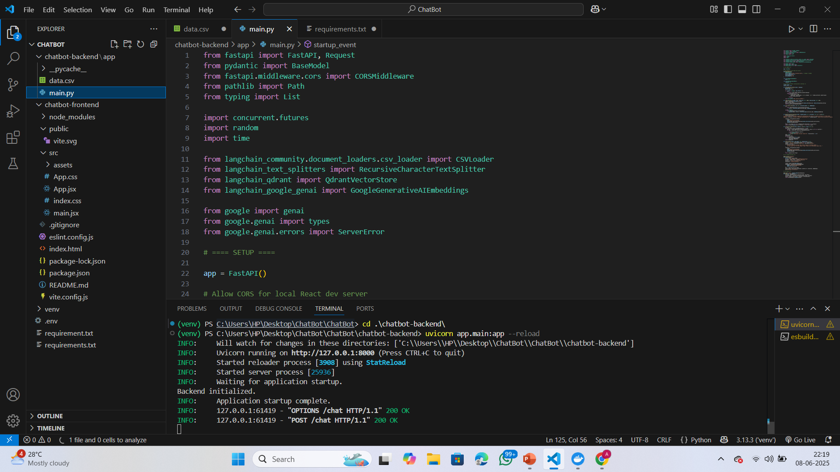
RESULTS
Video Demonstration :https://drive.google.com/file/d/1KxrK78EL4Wvh8qy8nPjxUUhFPmFopkuB/view?usp=sharing
Fig1:Running the Backend

Slide 28
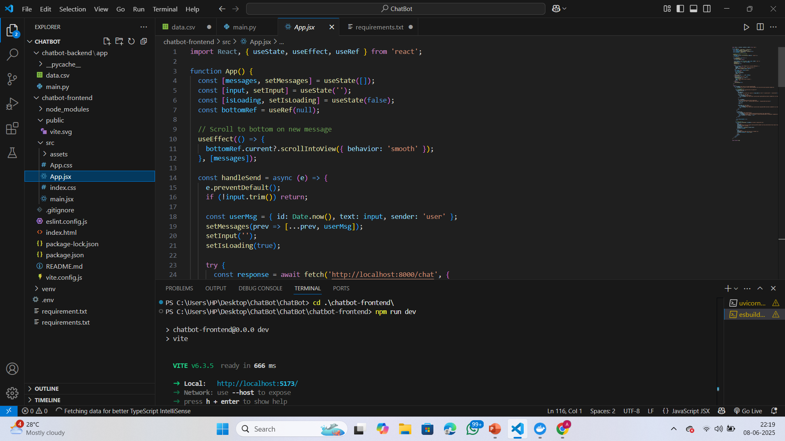
Fig2: Running the Front end

Slide 29
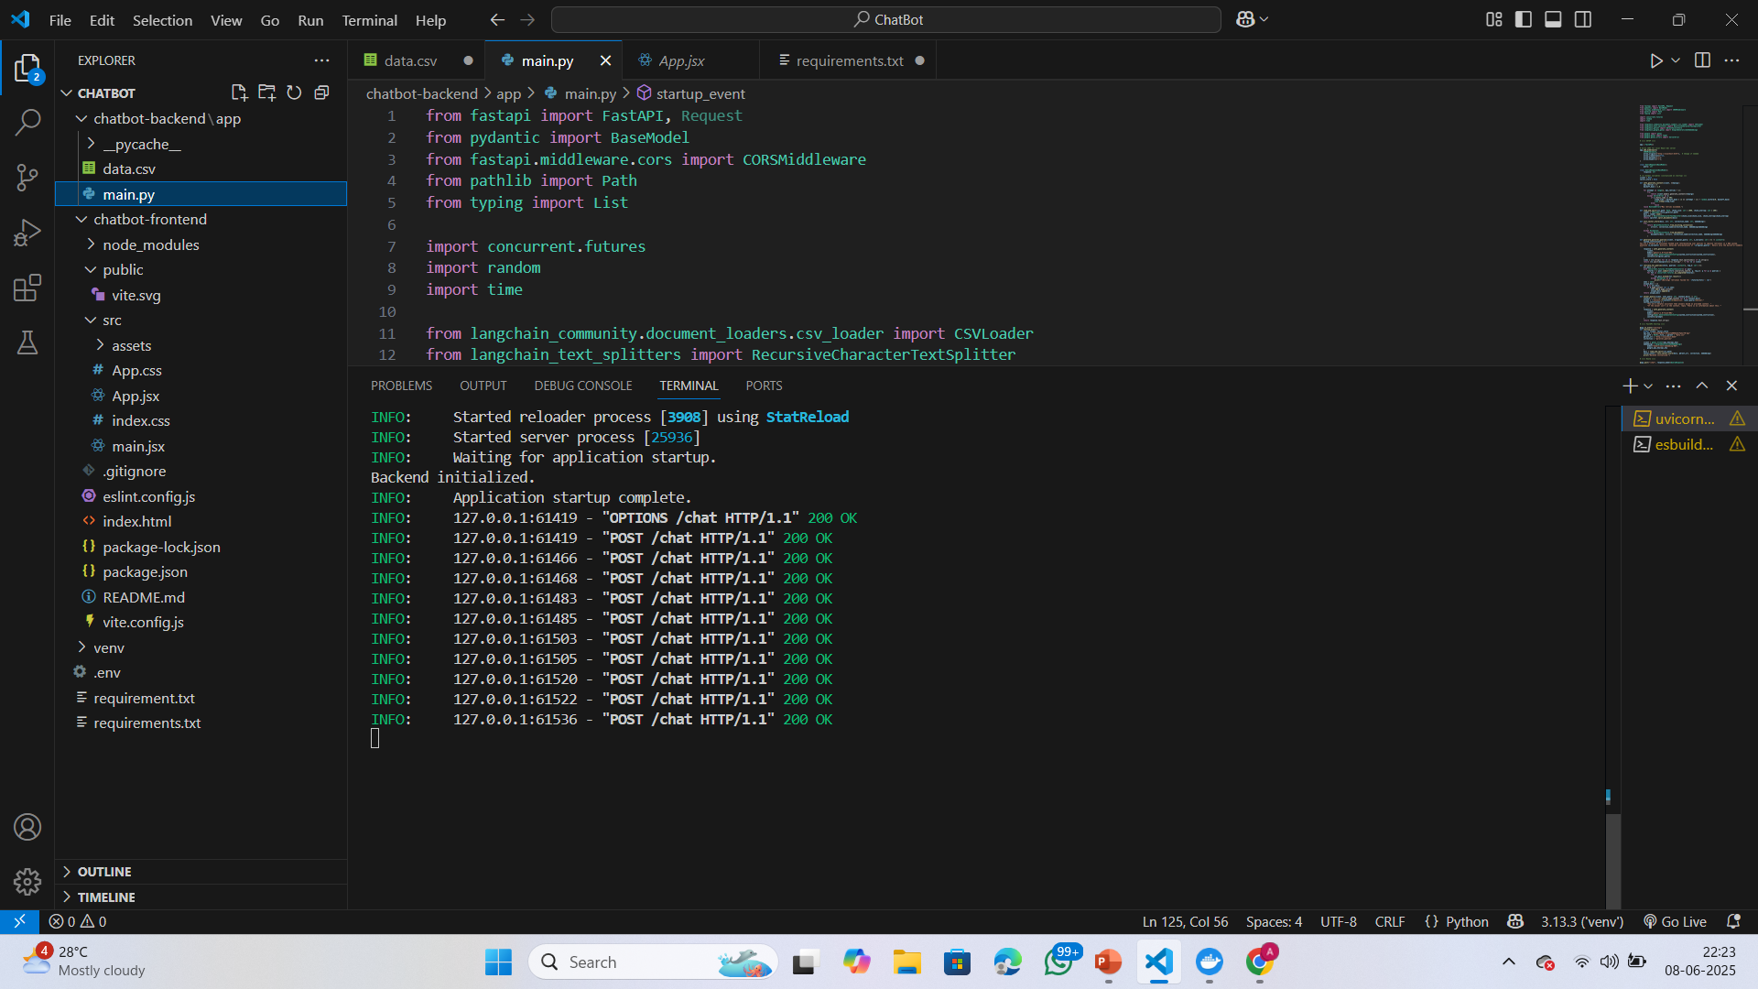
Fig 3:Backend Operation when we ask queries

Slide 30
TEST CASES
SNo | TEST CASE | INPUT | EXPECTED OUPUT | ACTUAL OUTPUT | REMARKS
1 | Enquiry about admission process | Admission | Admission to B.Tech programs at MGIT is through TS EAMCET. Candidates must qualify and participate in counseling | Admission to B.Tech programs at MGIT is through TS EAMCET. Candidates must qualify and participate in counseling. | Successful
2 | Enquiry about hostel | Hostel fee | ₹84,960 per year including accommodation and food. | ₹84,960 per year including accommodation and food. | Successful
3 | Enquiry about Fee Structure | fees | The fees per annum is Rs 1,60,000 plus 5,500 library fees. | The fees per annum is Rs 1,60,000 plus 5,500 library fees. | Successful
4 | Enquiry about scholarship | scholarship | Yes, MGIT supports government scholarships like E-PASS and private scholarships based on merit. | Yes, MGIT supports government scholarships like E-PASS and private scholarships based on merit. | Successful
5 | Fee circular | Fees circular | Link for the circular | https://mgit.ac.in/wp-content/uploads/2024/07/FEE-CIRCULARS-IV-SEMESTER-III-YEAR-2022-23 | Successful
6 | Enquiry for ranks | TSEamcet cutoff | Link for the circular | https://mgit.ac.in/wp-content/uploads/2025/03/TSEAMCET-2024-BATCH-FIRST-AND-LAST-RANK.pdf | Successful
7 | Invalid Question | Tell me a joke | No answer | I don't have an answer for that. Can you please ask something else? | Successful
8 | Enquiry about Syllabus | syllabus | Link for the syllabus | https://mgit.ac.in/regulations-syllabus2/ | Successful

Slide 31
TEST CASES
SNo | TEST CASE | INPUT | EXPECTED OUPUT | ACTUAL OUTPUT | REMARKS
1 | Bunking classes | Can we bunk the classes? | Regular attendance is important at MGIT for academic success. It is advised to attend all classes. | Regular attendance is important at MGIT for academic success. It is advised to attend all classes. | Successful
2 | MGIT bad college | Is MGIT a bad college? | MGIT is ranked among the top engineering colleges in Telangana with excellent faculty and infrastructure. | MGIT is ranked among the top engineering colleges in Telangana with excellent faculty and infrastructure | Successful
3 | Ragging at MGIT | Is ragging allowed at MGIT? | No. MGIT strictly follows anti-ragging laws to ensure student safety and a healthy campus environment. | No. MGIT strictly follows anti-ragging laws to ensure student safety and a healthy campus environment | Successful
4 | Mass bunking | Do teachers allow mass bunk at MGIT? | No. Regular attendance is mandatory for students. | No. Regular attendance is mandatory for students. | Successful
5 | Mobile phone usage | Are mobile phones allowed in classes at MGIT? | Mobile phones are restricted during lectures to maintain focus. | Mobile phones are restricted during lectures to maintain focus. | Successful

Slide 32
Video demonstration
https://drive.google.com/file/d/1KxrK78EL4Wvh8qy8nPjxUUhFPmFopkuB/view?usp=sharing

Slide 33
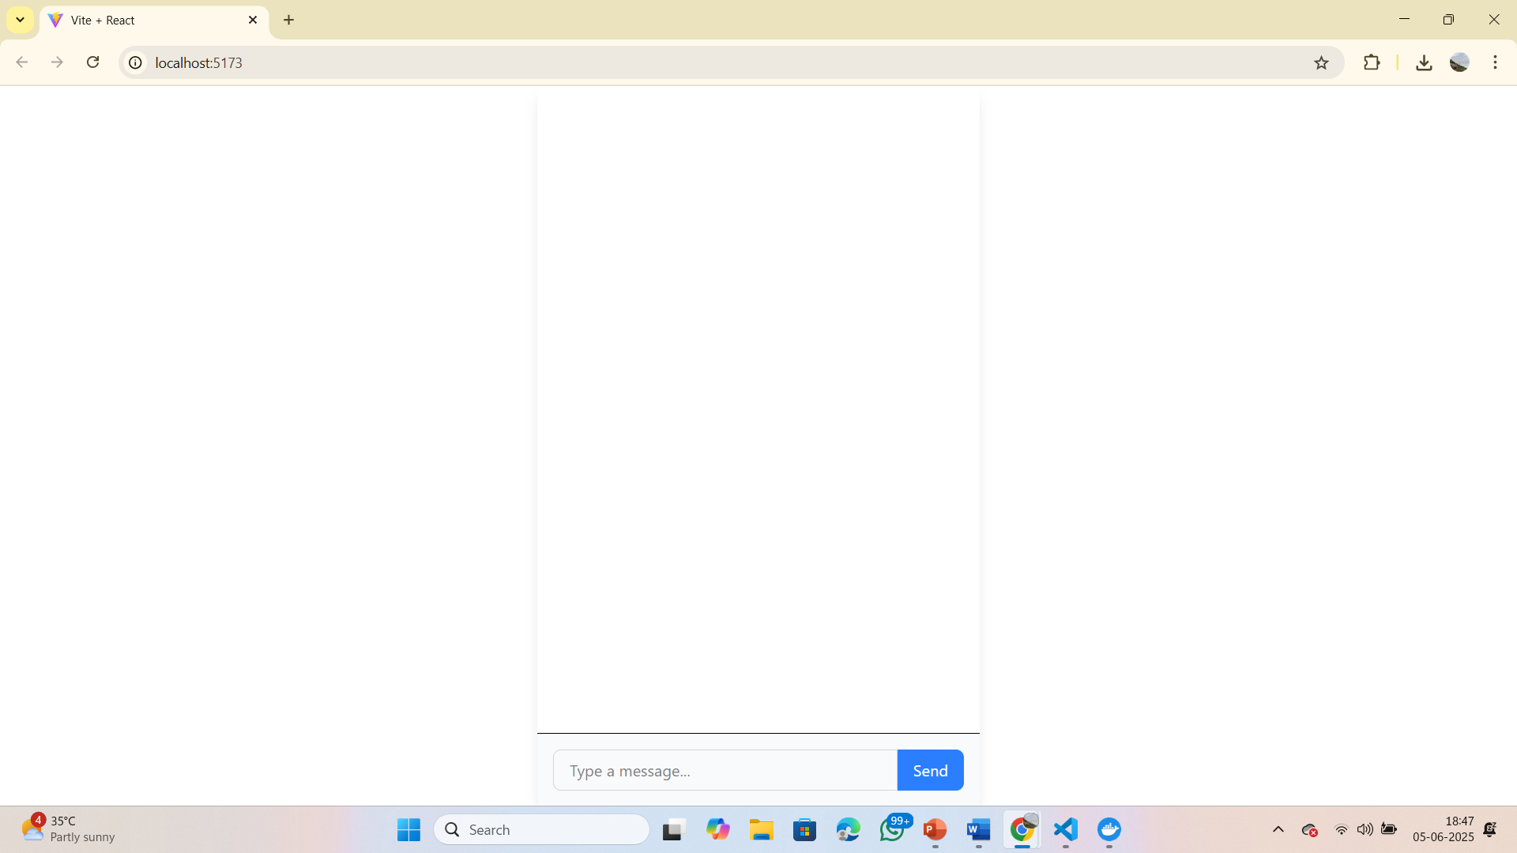
Fig4 Initial page
Fig shows the initial page displayed upon initially loading the local host address

Slide 34
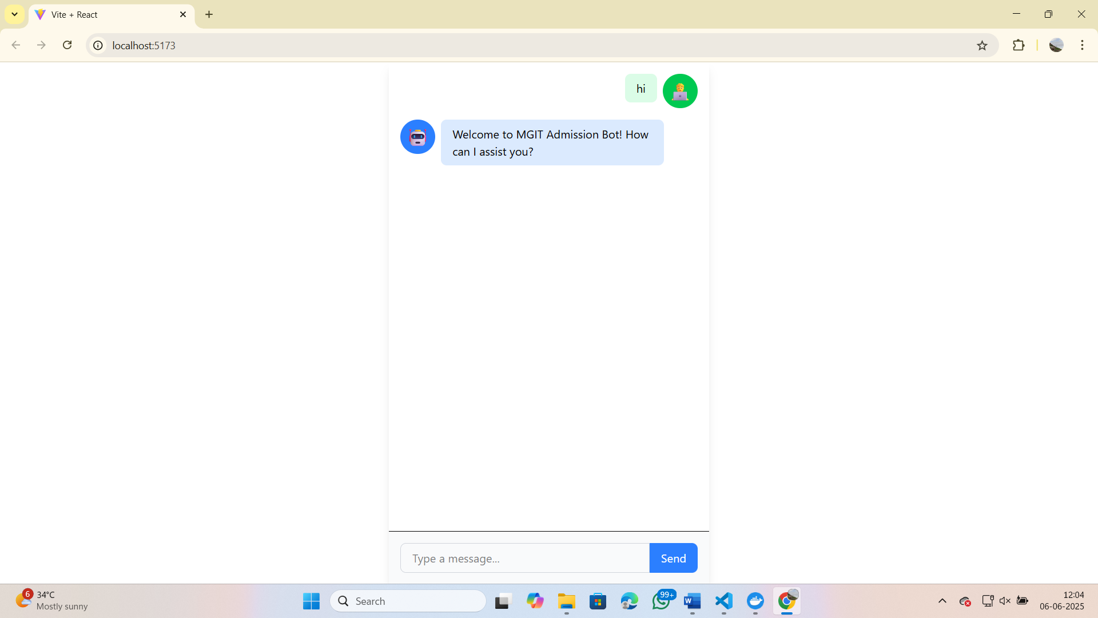
Fig. 5 Greetings
Fig.5 illustrates the initial interaction screen of the MGIT Admission Bot, showcasing a clean and intuitive chatbot interface. Upon launching the chat, the user inputs a greeting (“hi”), which triggers a predefined welcome message from the bot: “Welcome to MGIT Admission Bot! How can I assist you?”

Slide 35
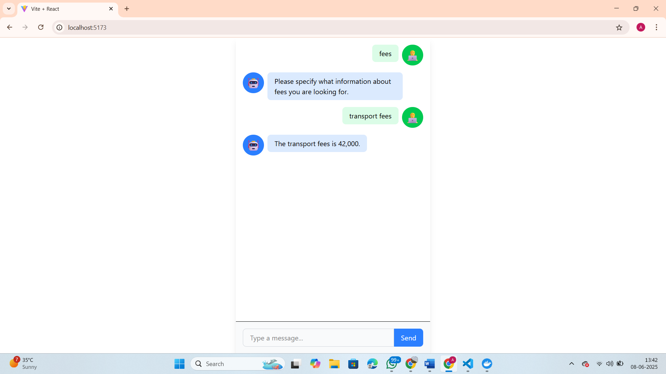
Fig 6:Fees
Fig.6 displays an informative interaction with the MGIT Admission Bot, showcasing its ability to handle domain-specific queries accurately. When the user types “fees,” the bot seeks clarification by asking, “Please specify what information about fees you are looking for.” Upon receiving the refined query “transport fees,” the chatbot responds with the specific answer: “The transport fees is 42,000.”

Slide 36
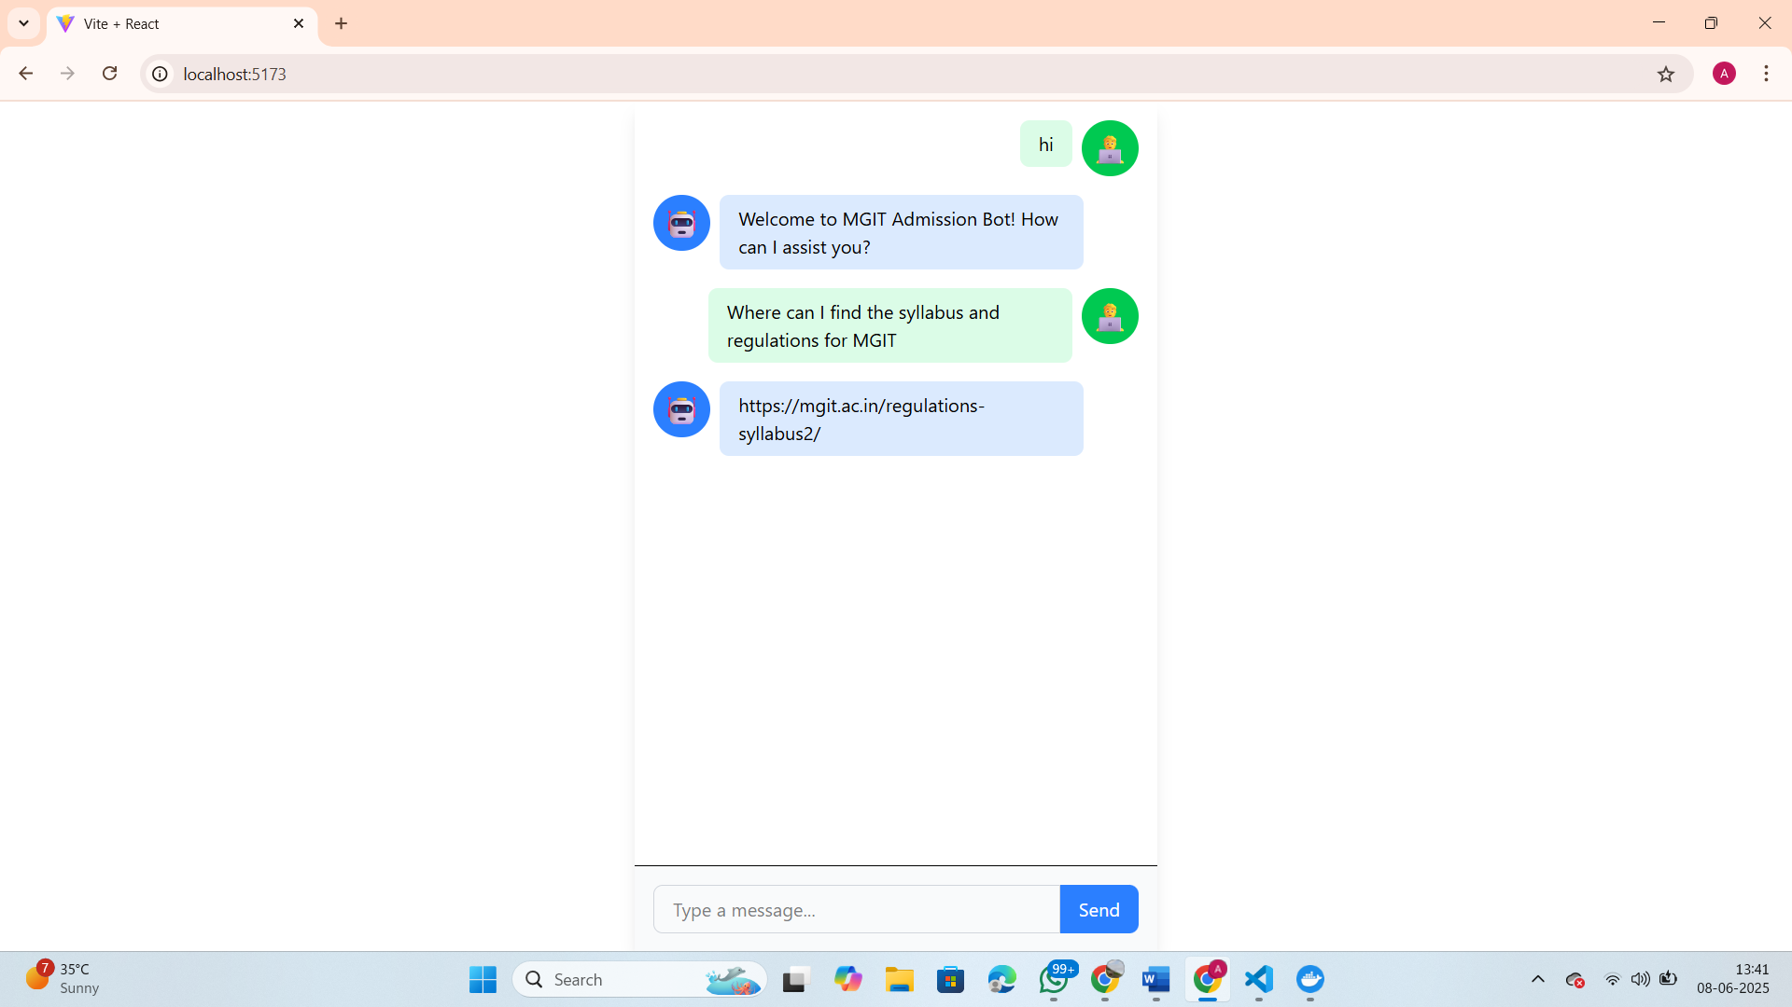
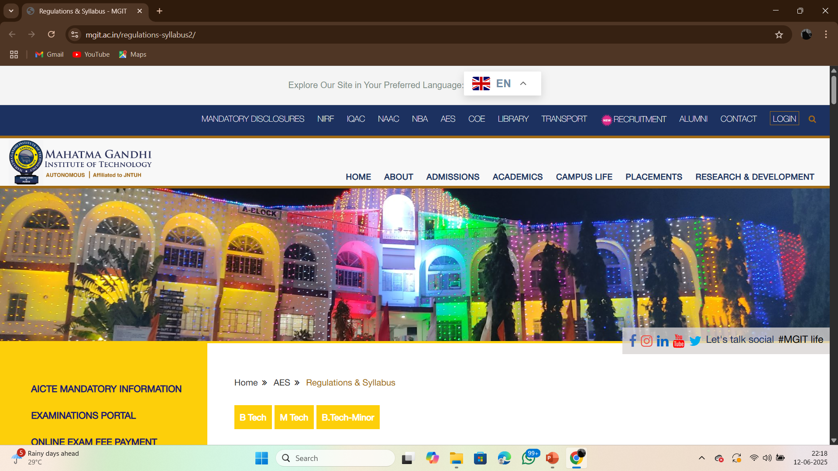
Fig 8: Output if we follow the link
Fig. 7Main page
Fig 7 displays an informative interaction with the MGIT Admission Bot, highlighting its ability to respond accurately to domain-specific queries. After the user greets the bot with a “hi,” the chatbot replies with a welcome message. The user then asks, “Where can I find the syllabus and regulations for MGIT?” The bot promptly provides a relevant and clickable URL:https://mgit.ac.in/regulations-syllabus2/

Slide 37
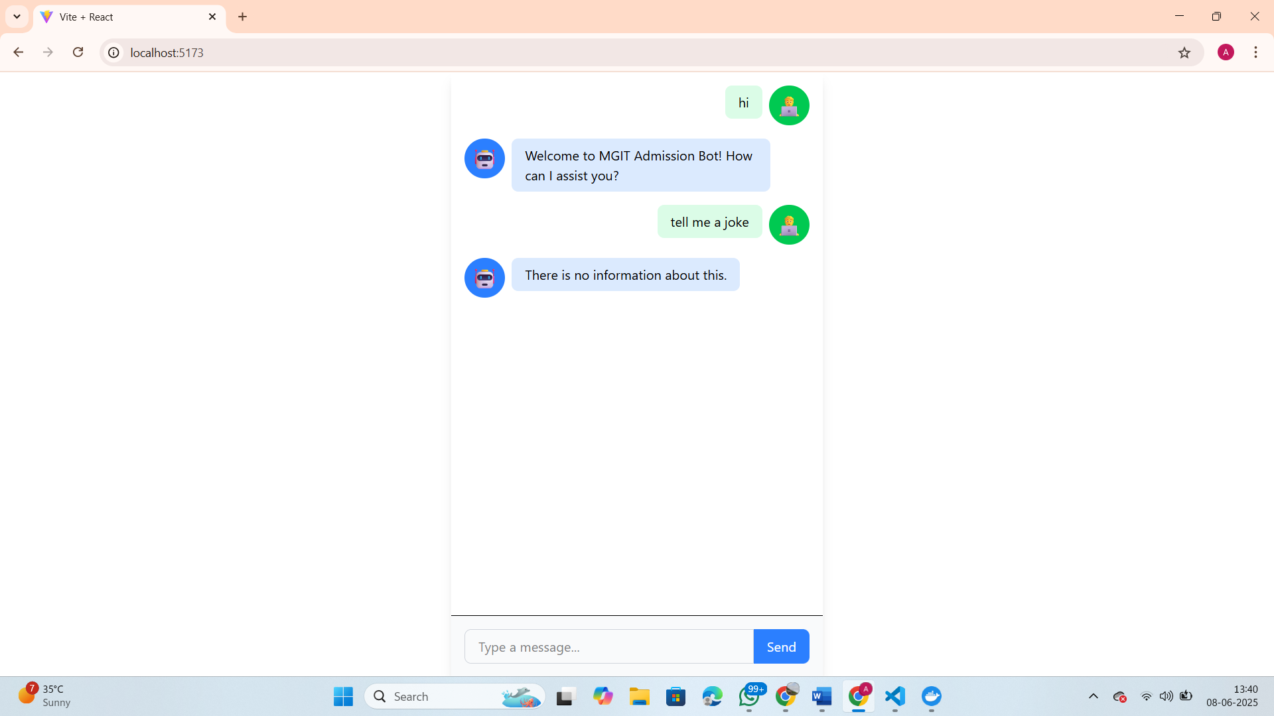
Fig. 8 Irrelevant Question
Fig. 8 Upon greeting the bot with a simple “hi,” the system responds with a welcoming message. However, when the user asks a non-domain-specific question like “tell me a joke,” the bot replies with a default message: “There is no information about this.”

Slide 38
CONCLUSION
The Admission Query Chatbot has been successfully developed to provide quick, accurate, and user-friendly responses to common queries related to the admission process at MGIT. It covers essential information such as fee details, admission ranks, syllabus links, academic calendar, and general campus-related queries. The chatbot is designed to handle frequently asked questions (FAQs) efficiently, guide users by providing direct links to official documents and resources, manage inappropriate or casual queries politely and professionally, and reduce the workload on human admission counselors by automating common query handling. By providing instant and consistent responses, the chatbot enhances the admission experience for prospective students and improves communication efficiency for the institution.

Slide 39
FUTURE ENCHANCEMENT
Multilingual Support (English, Telugu, Hindi).
Voice-Based Interaction with speech-to-text and text-to-speech.
Real-time Application Tracking and document updates.
Integration with WhatsApp/Telegram for wider access.
Document Upload and Verification during the admission process.

Slide 40
REFERNECES
[1] Khan UH, Khan MH, Ali R. Large Language Model based Educational Virtual Assistant using RAG Framework. Procedia Computer Science. 2025 Jan 1;25
[2] Parrales-Bravo F, Caicedo-Quiroz R, Barzola-Monteses J, Guillén-Mirabá J, Guzmán-Bedor O. Csm: a chatbot solution to manage student questions about payments and enrollment in university. IEEE Access. 2024 May 22..
[3] Patel D, Shetty N, Kapasi P, Kangriwala I. College enquiry chatbot using conversational AI. International Journal forResearch in Applied Science & Engineering Technology (IJRASET). 2023 May;11(5):2023.
[4] Nguyen TT, Le AD, Hoang HT, Nguyen T. NEU-chatbot: Chatbot for admission of National Economics University. Computers and Education: Artificial Intelligence. 2021 Jan 1;2:100036.

Slide 41

Thank you

